Slide 1

Fit or Fail a revolutionary fitness game
https://fit-or-fail.herokuapp.com/
Christian Sauls
Travis Stewart
Josh Shevitz
Kafui D
Adamma Newman

Slide 2
Purpose of The Game
Purpose
To create a fun, interactive learning experience that educates teens on consistent healthy lifestyle decisions such as diet and exercise
US Dept of Health and Human Services (DHHS) – “teens today are more likely to develop a sustained interest in a healthy, active lifestyle if they are provided with some type of technology-based “game-like” tool to stimulate their interest in the areas.“
Focus group: high school aged teens, eventually expanding to children of all ages
Primary platform: mobile

Slide 3

About Our Game
Online multiplayer trivia game
Questions to be chosen randomly from a pool of fitness-related questions
Game modes:
Simple trivia:
Solo – Play by yourself, answering a handful of randomly-chosen questions
Kahoot!-style trivia:
Online – Play for points competitively against other individuals
Users can create and join “Teams”
User accounts store data for cumulative points earned and total match victories
Users in a Team contribute their earnings to their Team’s statistics as well

Slide 4




Technologies Used
Front end
React
Next.js
JavaScript
HTML/CSS in JS
Bootstrap (reactstrap)
Back end
MongoDB (mongoose)
Node/Express.js
JSON Web Tokens
Domain/Hosting provider
Heroku
Collaboration
GitHub/Git
GroupMe
Google Hangouts
Miscellaneous
Stripe
Various npm packages (23 in total)

Slide 5
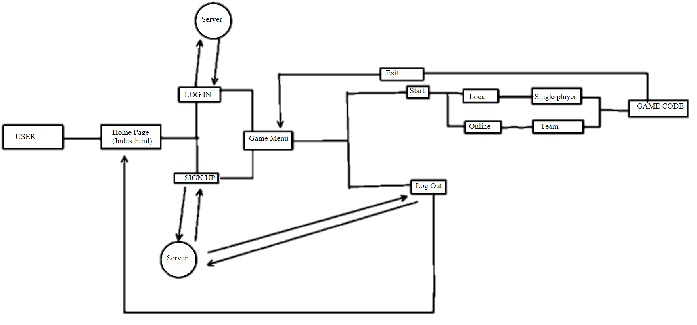
Website game layout

Slide 6
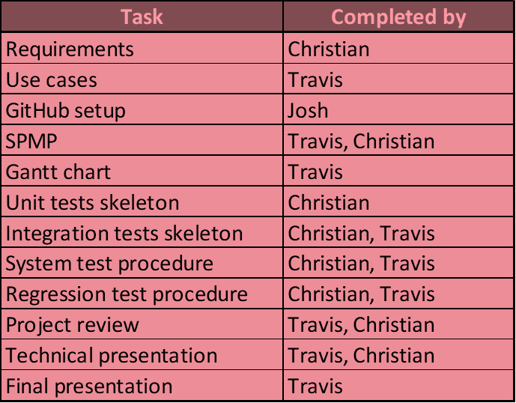
Roles and Contributions
Christian Sauls – Entire backend and frontend, primary designer, secondary documenter, coordinator
Travis Stewart – Primary documenter
Josh Shevitz – Secondary frontend and designer, POC, coordinator
Adamma Newman – Updated the requirements document
Kafui D – Made the game selection page (/game/index.js)

Slide 7
Live Presentation
https://fit-or-fail.herokuapp.com/

Slide 8
Next Steps
Live multiplayer mode
Kahoot!
User Teams
Continue to add questions to the game
Separation of question categories; different game “themes”
Ex: Healthy eating, muscle development, etc.
Full donations implementation
Work with advertisers to curate appropriate advertising and consistent funding
System for ads to be reviews by government officials before they’re posted
New features coming in the future, such as:
Custom profile pictures
Editable userpages
Bio, background color
Friends list
Donor role
Detailed site-wide statistics, categorized by month
Generally-improved API
General site maintenance and testing
Add animations throughout for a smoother user experience
More diverse typography
Mobile optimizations where needed

Slide 9



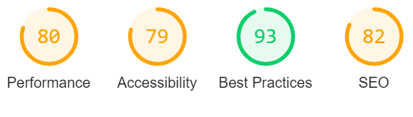
What Sets Our Product Apart
Mobile-first, garnering the most traffic, especially for our target demographic
Next.js
Not just another bulky create-react-app
Server-Side Rendering and pre-rendering to static HTML
Pages delivered blazingly fast: place static files on the edge (CDN)
SEO-friendly
Future-proof in terms of web development trends
Deployment of site is simple and fast
One of the most popular React frameworks that has continuous growth
Netflix, Tencent, Hulu, GitHub, Twitch, Uber, Starbucks, Docker, Coinbase…
Just received $21M Series A Funding
Entirely custom
Written in the languages that developers already know and love
Not predicated on restrictive 3rd-party services or obscure technologies
Easy to expand and tweak on the fly

